Slide 1
John Brown’s Raid
Harper’s Ferry, Virginia
October 1859

Slide 2
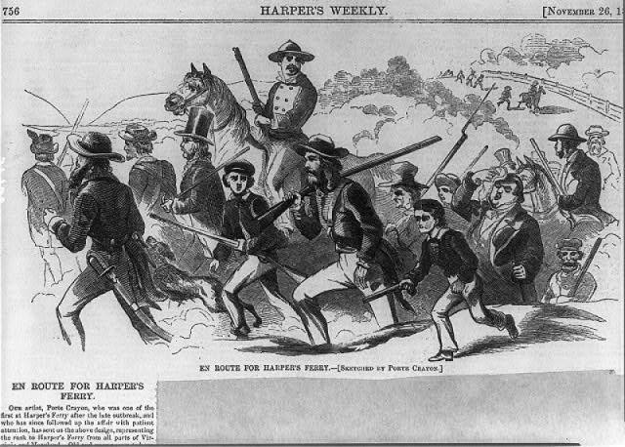
John Brown Plans Raid
Notes:
John Brown and twenty-two other men raided the town of Harpers Ferry, Virginia, hoping to arm and free slaves. He choose Harpers Ferry because it had an armory (a place where guns are made) and an arsenal (a place where guns are stored).

Slide 3
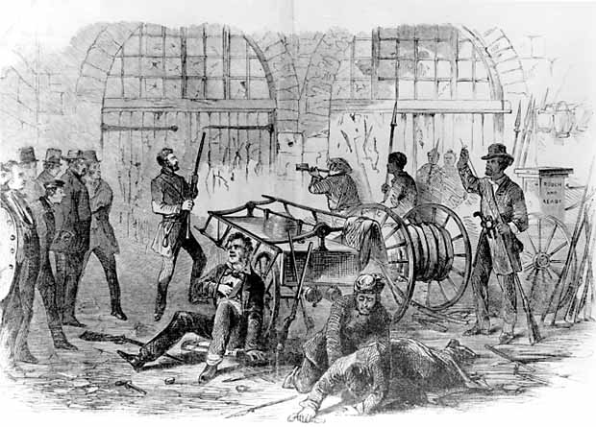
John Brown Raids Harper’s Ferry
Notes:
Brown and his raiders captured many of the town’s most important citizens and held them hostage.

Slide 4
Results of John Brown’s Raid
Notes:
Brown was unsuccessful in arming and freeing slaves for his raid.
The next morning Brown was captured and wounded. He was then convicted of treason, murder, and conspiracy to incite slave rebellion. Brown was hanged that December.

Slide 5
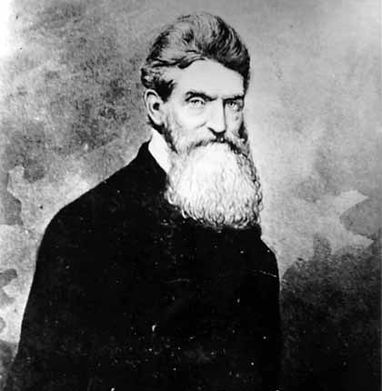
“I, John Brown, am now quite certain that the crimes of this guilty land will never be purged away but with blood.”
Notes:
"I, John Brown, am now quite certain that the crimes of this guilty land will never be purged away but with blood."

Slide 6
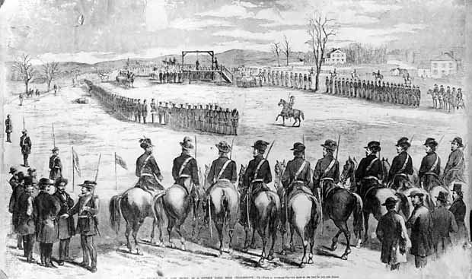
John Brown was hanged on Dec. 2, 1859
Notes:
John Brown was hanged on December 2, 1859.

Slide 7
Letter to the London News Regarding John Brown By Victor Hugo 1859
Excerpt:
“A white man, a free man, John Brown, sought to deliver these negro slaves from bondage. Assuredly, if insurrection is ever a sacred duty, it must be when it is directed against Slavery…he sounded to these men, these oppressed brothers, the rallying cry of Freedom.”

Slide 8
A Letter To Mr. & Mrs. James H. Burton From George Mauzy, a citizen of Harpers Ferry, Virginia December 3, 1859
Excerpt: “This has been one of the most remarkable circumstances that ever occurred in this country, this old fanatic made no confession whatever, nor concession that he was wrong, but contended that he was right in everything he done, that he done great service to God, would not let a minister of any denomination come near or say anything to him, but what else could be expected from him…”

Slide 9
Discussion
Watch the John Brown Raid video. Click here.
What was John Brown trying to do when he raided Harpers Ferry?
Why would he want to do this?
Were reactions to his actions the same throughout the country?
Who might be upset by his actions and reasons for taking action?
Who might be upset by his actions, but not his reason?

